Slide 1
Childhood Immunisation Processes
By Shena Patel- Local Immunisation Coordinator

Slide 2
Key Messages
Key Messages:
● Childhood infections like measles and whooping cough are rising. If your child isn’t vaccinated, they’re not protected. Childhood infections can cause serious illness, hospitalisation and life-long disabilities.
● Childhood vaccinations give your children the best protection and prevent over 5,000 deaths and over 100,000 hospital admissions each year in England. ​
● If you are unsure speak to your GP or visit www.nhs.uk/childhoodvaccinations to find out if you should book an appointment for your child. ​
● All childhood vaccinations are free. For the full timetable visit the NHS website and to see how to get them.​
● All childhood vaccinations offered by the NHS have been used in millions of children worldwide and have an excellent safety record.
● All medicines can cause side effects, but all health authorities around the world agree that immunisation is the safest way to protect our children’s health.

Slide 3
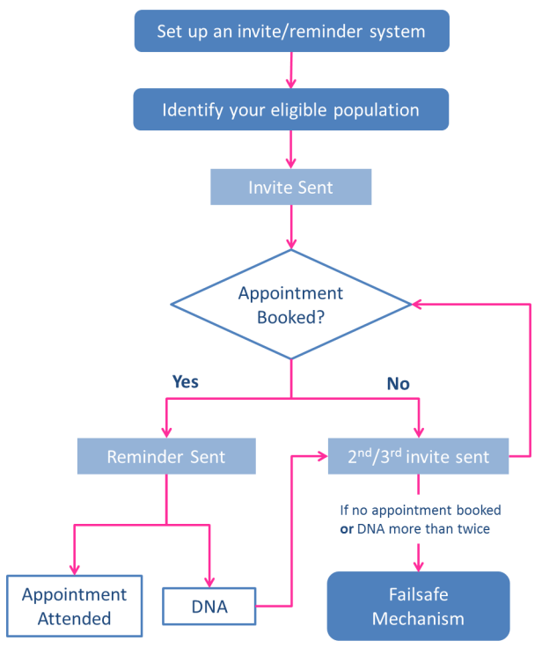
Call and Recall- Optimising Your System
Consider system searches direct booking SMS Links for instant uptake
Checking newly register patients vaccine status especially new migrant, asylum seekers and refugees
Opportunistic Vaccine
Discussion with a clinician
Check if borough resident
Consider digital poverty
Consider safeguarding concerns (not just due to vaccines refusal)
Consider personal beliefs around immunisation
Consider barriers to access (language/literacy appointment times)
Liaising with other professionals (Health Visitors)
https://www.england.nhs.uk/london/wp-content/uploads/sites/8/2021/12/Good-Practice-Immunisation-Invite-Reminder-Guide.pdf

Slide 4
Data Cleansing
Admin Lead/Practice Nurse | Action
Declined | Code decline on patient's record, also document national catch up campaign is offered if parents change their mind.
Call back | Person answering has requested to call back another time
Moved Abroad | Task the Practice admin or management team to request deduction
Already vaccinated | Investigate where vaccinated, request evidence be photographed and emailed to then be coded as appropriate
Appointment booked at Practice | Ensure sms confirmation is sent if they would like it
Appointment booked at Pilot Imms Clinic | Ensure sms confirmation is sent if they would like it
Following Abroad schedule | Advise the reasons for following UK schedule (ie: not missing out on some vaccinations, UK vaccines offered according to local risk etc). Ensure all vaccinations given abroad are coded appropriately.
Deducted (Patient no longer registered with the Practice within CL/WL) | No further action if deduction complete
Moved Area | Task the Practice admin or management team to inform and request deduction
Investigate | Vaccinations unclear from the record or need support in translation of records not correctly coded from management
No phone number | Task the Practice admin or management team to request letter be sent
Phone number not working | Task the Practice admin or management team to request letter be sent
Vaccinated Privately | Request vaccination evidence be emailed or taken to a clinic to be coded correctly
Up to date | No further action
Vaccinated abroad | Request vaccination evidence be emailed or taken to a clinic to be coded correctly
Other ie wishes to delay, unwell currently | Note in patient notes
Cleansing data every two weeks, allows practices to get rid of ghost patients.

Slide 5
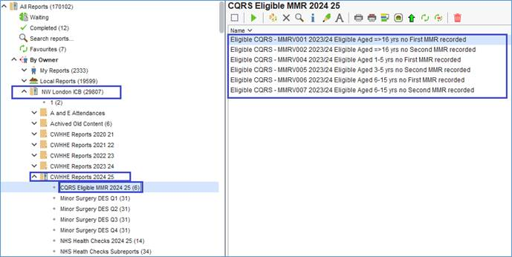
Systemone Searches for older children
They are requesting GP practices to
Run searches for any children who have not received either one or both doses of the MMR vaccination as per the Routine UK Schedule and invite children with an uncertain or incomplete immunisation status for vaccination as soon as possible.
Check immunisation histories for all new entrants from abroad and newly registered patients of all ages.
Ensure that appropriate triage and isolation procedures are in place so that those presenting with a fever and rash can be isolated immediately, to avoid exposing others.

Slide 6
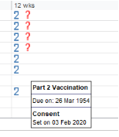
Tips and Tricks of childhood immunisation process
Delegate a lead nurse for childhood immunisations
Have a protected admin sessions for recalling and organising imms appointments
Educate reception staff on where to find on Systemone due dates of vaccines according to the UK schedule, For example what date 1st imms are due and when to book (on or after the date specified on the records)(screenshot of what I mean​ below)
4. Children new registration forms to be sent to nurses to check imms are up to date and input data if needed
5. To continue to use PHE immunisation webinars for regular update
6. Use PHE online resources ie> incomplete immunisation algorithm
7. To stock alternative vaccines at all times to cater for more child ie priorix and mmr vax pro
8. Recalling system: x3 SMS reminders, x3 telephone calls and send a letter home
9. To follow up DNA appointments by calling or sending SMS
Areas of support:
To know more about opportunities in the community to aid the uptake of vaccinations

Slide 7
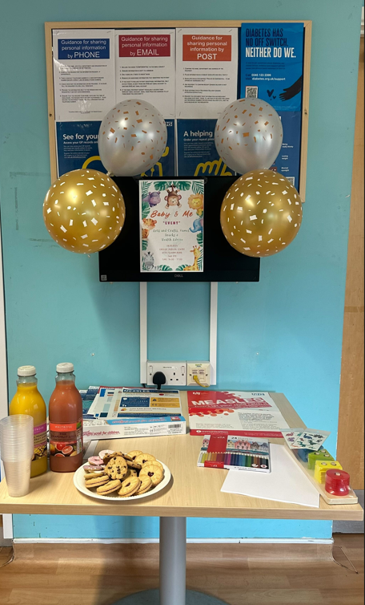
Practice Led drop in clinic
Key messages learnt:
Few patients that did turn up were grateful that the event took place, and gained further knowledge of the importance of immunisation and keeping up to date with immunising their children.
The leaflets were beneficial - they weren’t too overwhelming but rather educational.
Arrange further events - parents don't understand the importance of immunisation, and future events would be important (the ones who attend have expressed this).
The outcome of the event at Cassidy Road.
Only 2 people attended the event with the addition of their practice nurse, HCA and PPG lead. No appointments were booked at those who attended were up to date with their immunisations.

Slide 8
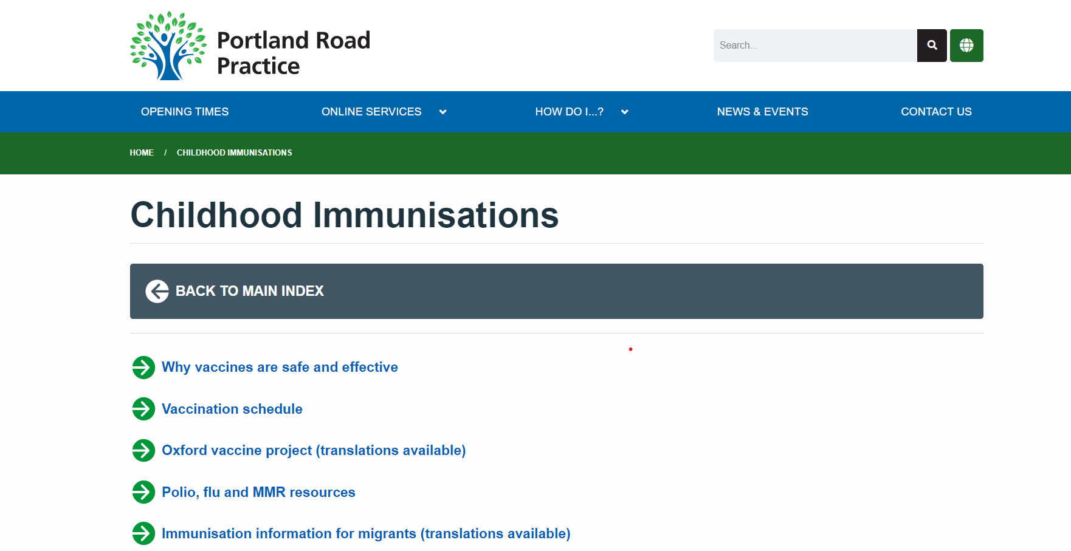
Practice Website update
Portland Road Practice, have updated there practice website with correct and current links that can be sent across to families whilst completing call/recall.

Slide 9
Useful Links
NHS England: Childhood vaccinations NHS vaccinations and when to have them - NHS (www.nhs.uk)
NHS England: Why vaccination is important and the safest way to protect yourself Why vaccination is important and the safest way to protect yourself - NHS (www.nhs.uk)
UKHSA blog: Protecting your children through vaccination - UK Health Security Protecting your children through vaccination – UK Health Security Agency (blog.gov.uk)
Department for Education blog: What to do if you think your child has measles and
when to keep them off school - The Education Hub What to do if you think your child has measles and when to keep them off school – The Education Hub (blog.gov.uk)
Publications and assets for childhood immunisations can be downloaded and ordered for free by healthcare professionals on the Health Publications website. Home - Health Publications
UKHSA further information:
Immunisation - GOV.UK (www.gov.uk)
Immunisations: babies up to 13 months of age - GOV.UK (www.gov.uk)
Immunisations at one year of age - GOV.UK (www.gov.uk)
Pre-school vaccinations: guide to vaccinations from 2 to 5 years - GOV.UK (www.gov.uk)
MMR vaccination: Have you had your MMR? - GOV.UK (www.gov.uk)
What to expect after vaccinations - GOV.UK (www.gov.uk)
Vaccines and porcine gelatine - GOV.UK (www.gov.uk)
Use of human and animal products in vaccines - GOV.UK (www.gov.uk)
Immunisation information for migrants - GOV.UK (www.gov.uk)

Slide 10
Any Questions?

