Slide 1
Barlby Surgery
Patient Participation Group
June 2022

Slide 2
What is a PPG?
PPG works with the practice to:
Offer patient perspective on services provided by the practice
Contribute to the continuous improvement of services
Foster improved communication between the practice and its patients
Help patients to take more responsibility for their health
Provide practical support and help to implement change
Please remember that this meeting is NOT about complaints or personal issues

Slide 3
Advantages for practice and patients
The practice will be able to plan services jointly with patients
Get closer to the community for whom they care
Help patients with non-medical and social care issues
Get help from patients to meet targets and objectives
Have a forum to voice ideas and concerns

Slide 4
Meet the team .
Clinical Team
Dr Ali Bihi | Clinical Lead GP
Dr Naseer | GP
Dr Gareth Patterson | GP
Dr Sabri Trepca | GP
Katherine Little | physician associate
Shweta Khanna | Lead pharmacist
Alia Reza | Pharmacist
Dr Anjeet Rekhi | FY2 Doctor
Admin Team
Donna Seymour | Practice Manager
Uthman Arshad | Assistant Practice manager
Noemi | Practice Administrator

Slide 5
Prescribing Pharmacist
What can a Pharmacist do ?
Sign Prescriptions
Medication Reviews
Minor Ailments eg Sore throat , nail infection …etc
Chronic Care Conditions eg Diabetes , Asthma ,Hypertension .
Skin Conditions eg Eczema
Contraception
Mental Health
MSK presentations
What can a Pharmacist NOT do ?
Children under 10 yrs old
Abdominal Pain
Dizziness
Neurological presentations
Pregnant patients
Complex health issues

Slide 6
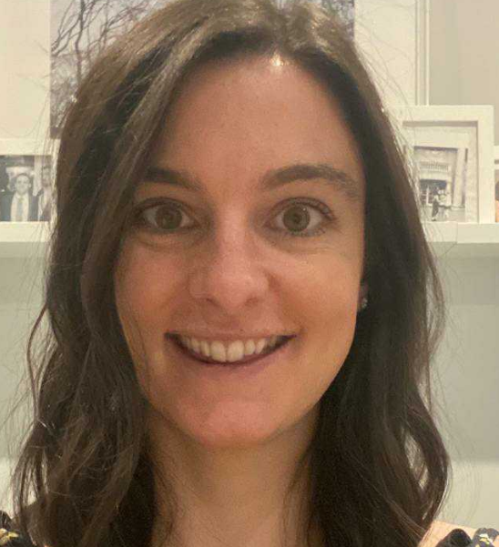
Presentation from Katherine little
Katherine is our Physicians Associate who joined the practice in December of 2021.

Slide 7
What is a PA?
Profession started in the US in the 1960’s, was formally introduced to the UK in 2003
PAs physician associates are clinicians who work along side physicians (GP’s) to provide medical care, they are an integral part of the medical team
This means they are enabled by collaboration and supportive working relationships with their senior physician who can discuss cases give advice and attend to patients as necessary
Trusted, rigorously educated and trained healthcare professionals, PAs are dedicated to expanding access to care and transforming health and wellness through patient-centered, team-based medical practice

Slide 8
What education does a PA have?
PA’s are educated modelled on the medical school curriculum and include both didactic and clinical rotations
They require a bachelor’s degree and completion in courses in basic and behavioural sciences as prerequisitses
Programs are approximately 27 months on average (three academic years) and include classroom instruction and more than 2,000 hours of clinical rotations
Clinical rotations include- surgical disciplines, general medicine, gynaecology, paediatrics, emergency medicine and psychiatry

Slide 9
What can PA’s do?
Take medical histories
Conduct physical exams
Diagnose and treat illness
Order and interpret tests
Develop treatment plans
Counsel on prenetative care
Perform procedures
Make rounds in hospitals and nursing homes
Do Clinical research
They currently can not- prescribe medications or request ionization radiation (cxr or ct scans)

Slide 10
Appointment bookings
When an e-consultation is submitted on Dr iQ this is triaged by the DUTY DOCTOR
Similarly, if you call the practice or come to reception requesting an appointment – staff will discuss this with DUTY DOCTOR
PLEASE NOTE: We aim to see everyone who is requesting an appointment on the same day. If you wish to be SEEN vs TELEPHONE – We will always aim to accommodate your request.
Dr contacting you straight away to the admin contacting you for further information if required. Sometimes this is done so its more efficient for the clinician dealing with your query and have a rough idea of what needs assessing when they are contacting you.

Slide 11
Concerns raised by patients
You said | We did
No pre-bookable appointments | As we offer same day appointment service, pre-bookable slot is only booked if absolutely necessary. Admin have also been trained on how to promote and explain the process so its more understandable for patients.
Medications being sent to wrong pharmacy or not being sent at all | For all admin and clinicians to check for correct pharmacy upon issuing and requesting. Patients to be informed if unable to send medications via email, telephone and SMS.
Unwelcoming & Rude Receptionist | We have nearly a whole new reception. We have implemented a new way of training which is regularly monitored

Slide 12
Message from the clinical lead & Practice management team
Dr Bihi and myself would like to thank you all for giving up your time to attend today’s PPG meeting. We are both very keen to improve the relationship between the practice and our patient community and hope by actively engaging in regular PPG meetings that this will assist us in doing so.
Our team care a great deal about Barlby surgery and its patients and are very passionate to improve patient experience.

Slide 13
Any Questions ?

Slide 14
www.westlondonpractice.co.uk

